Slide 1
SIGNIFICANCE OF NANOTECHNOLOGY IN CONSTRUCTION ENGINEERING

Slide 2
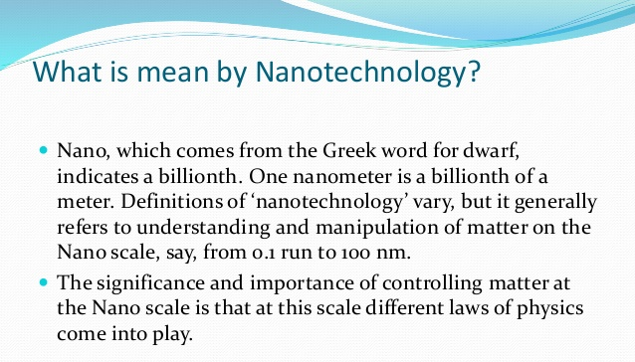

Slide 3
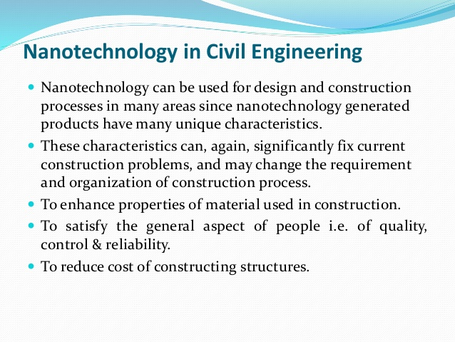

Slide 4
Nanotechnology encircles two important approaches and they are:
The bigger structures are decreased in size to nanoscale by sustaining their genuine properties
TOP DOWN APPROACH
also known as “molecular manufacturing” and “molecular nanotechnology”, in this the materials go through the machines from components of the molecule via a process of self-gathering.
BOTTOM UP APPROACH

Slide 5
USE OF NANO REINFORCEMNETS
Carbon nanotubes/carbon nanofibers are latent things which are based on cement.
The carbon nanotubes/ nanofibers are the excellent nanomaterials for developing the mechanical properties of materials which are based on cement.
The single-wall carbon nanotubes, multi-wall carbon nanotubes and also the carbon nanofibers are high structured materials based on the graphene ring with high ratios of aspect and large areas of the surface.
Carbon nanotubes can affect the hydration of early age and from this, the existence of a powerful bond between the carbon nanotubes and cement paste is possible.

Slide 6
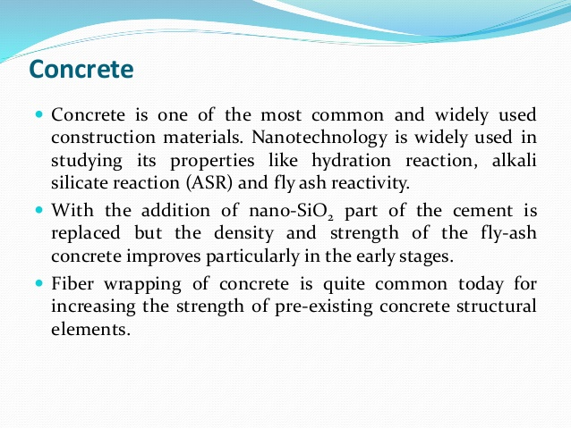

Slide 7
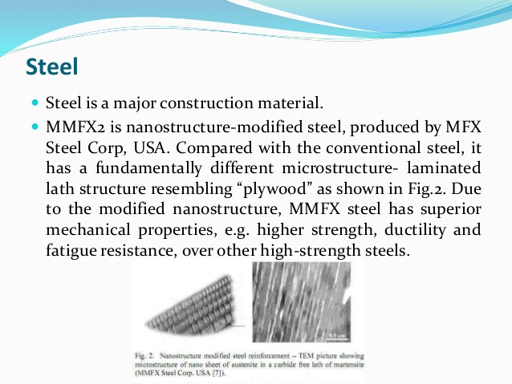

Slide 8
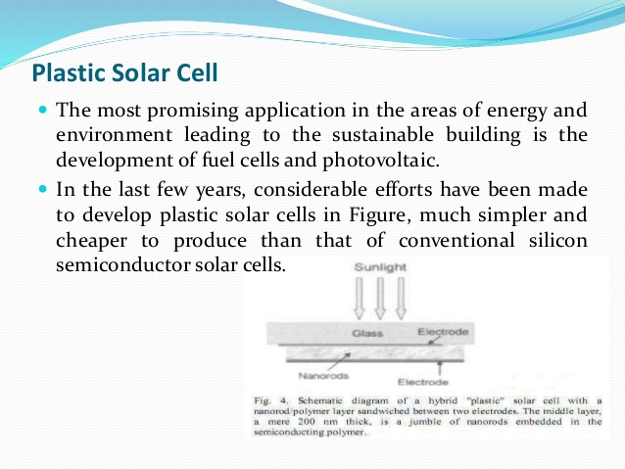

Slide 9
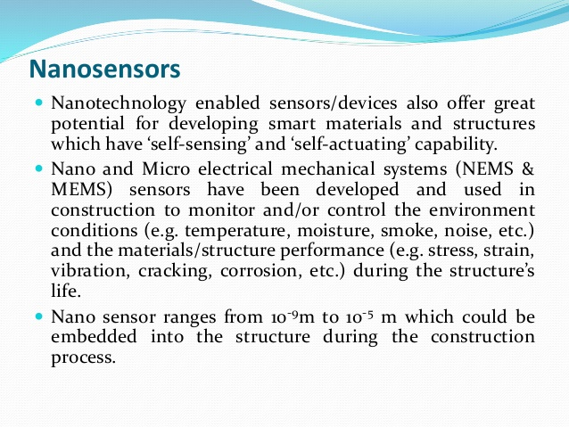

Slide 10
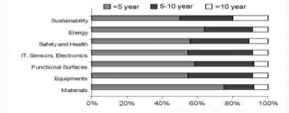
Future Projection of nanotechnology in Construction:
There is a substantial money flowing into Nano-related research from multinational corporations and venture capital investments
Many of the world’s largest companies such as Boeing, Hitachi, etc. have all had significant Nano-related research projects going on, or launched their own nanotech initiatives.

Slide 11
DISADVANTAGES:
Because of their particle size, Nano particles have the potential to negatively affect the respiratory and digestive tracks and the skin or eye surface, thus exposes workers to hazards.
Small production volumes and high cost remain the main barriers to the use of nanotechnology.
Time of commercializing a product is long.
Health Risks

Slide 12
NANOTECHNOLOGY AND FIRE PROTECTION
Fire resistance of steel buildings is commonly furnished by a coating generated by a spray on the process of cementitious
Fibers of polypropylene are another method of enhancing fire resistance and this method is an affordable method when compared with the common insulation method.
Present coatings which are based on Portland cement are not very famous as they require being thick and the adding of polymers is required to enhance adhesion property

Slide 13
FUTURE CHALLENGES AND DIRECTIONS
Future challenges and limitations of nanotechnology in the field of construction engineering are studied with more importance; the future challenges and directions of nanotechnology are as below:
Fabrication
Health
Environment
Cost
Well, we need to solve the present challenges before the nanotechnology immerses completely in the applications of concrete.

Slide 14
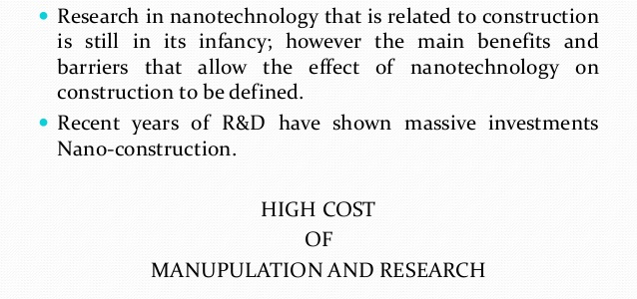
CONCLUSION

